Slide 1
BRITISH AIRWAYS CUSTOMER REVIEWS ANALYSIS
By:Sharon Muiruri

Slide 2
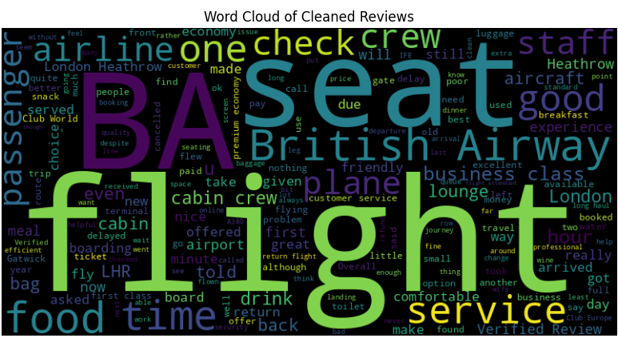
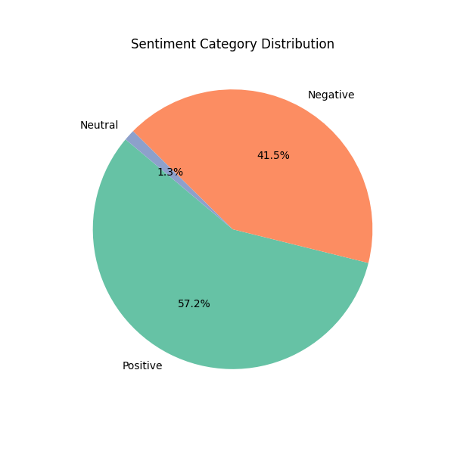
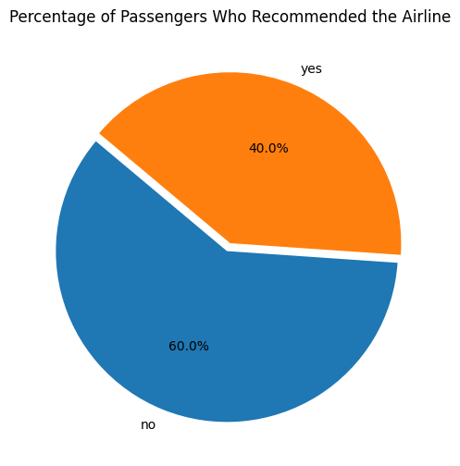
Key Insights
- The overall average rating score for the airline was 4.68
- 57% of the reviews were positive, while 41% were negative and 1 % neutral.
- 60% of passengers would not recommend the airline, suggesting potential areas of dissatisfaction or unmet expectations in services provided by the airline.
- Majority of the reviews have themes around service quality, comfort, food, airport logistics, and seating. These insights could guide BA to target improvements in service, comfort, and catering to enhance customer satisfaction.

Slide 3
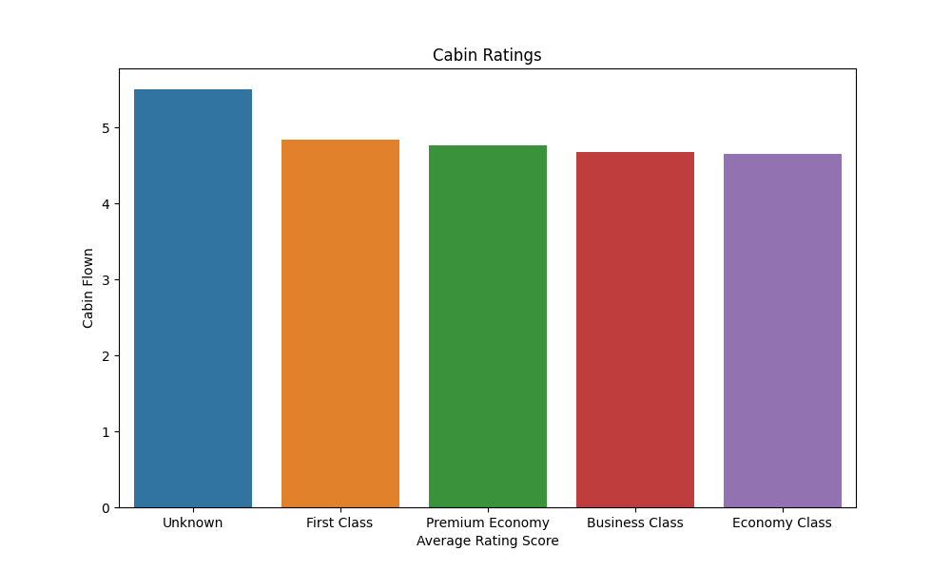
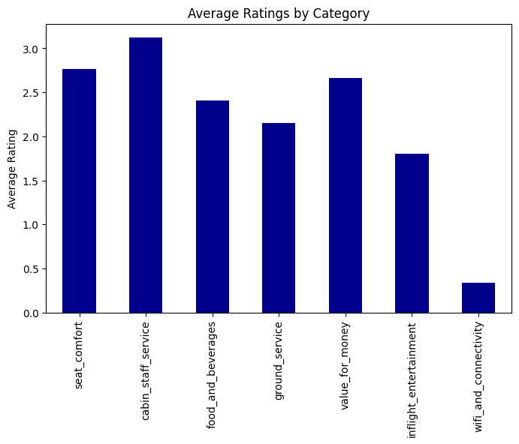
- The ratings indicate a positive experience for premium cabins (First and Premium Economy), while Economy and Business Class show areas where British Airways could focus on enhancing service or comfort.
- Improving Economy Class and maintaining high standards in premium cabins can help BA ensure better overall customer satisfaction across all cabin classes.
- Cabin and Staff Service have the highest average rating, indicating that passengers are generally satisfied with the service provided by the cabin crew. This suggests that the staff’s professionalism and friendliness are positively perceived.
- There are notable areas for improvement, particularly in inflight entertainment and WiFi connectivity. Enhancing these lower-rated aspects could lead to a more balanced and satisfactory passenger experience.

Slide 4
Business Recommendations
- To enhance customer satisfaction, the airline should focus on improving key areas of dissatisfaction, particularly WiFi connectivity, inflight entertainment, and Economy Class services. Upgrading onboard WiFi to ensure reliable access, updating entertainment options with more diverse content, and enhancing seat comfort in Economy can significantly elevate the passenger experience.
- Improving food and beverage quality by offering diverse, high-quality menus across all cabins and addressing gaps in Business Class services, such as seating and meal options, will further boost customer satisfaction.
- Additionally, streamlining ground services like check-in, boarding, and baggage handling can make the travel process smoother and more efficient.
- Maintaining high standards in premium cabins, where customer satisfaction is already strong, is essential to retain loyal passengers. BA should continue highlighting their strengths, such as excellent cabin staff service, in marketing campaigns while introducing initiatives to improve the perceived value for money, such as loyalty programs and promotional offers.
- Actively collecting and acting on passenger feedback, alongside transparent communication about improvements, will help build trust and loyalty.
By addressing these focus areas, British Airways can balance meeting passenger expectations with delivering a premium experience that justifies its pricing.

